Slide 1
CMC technologies
Teknosolar
Hecho por: Carlos García, Marc y Cristina

Slide 2
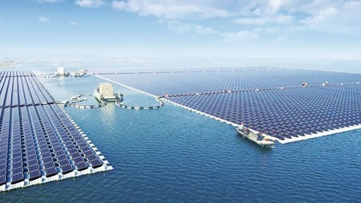
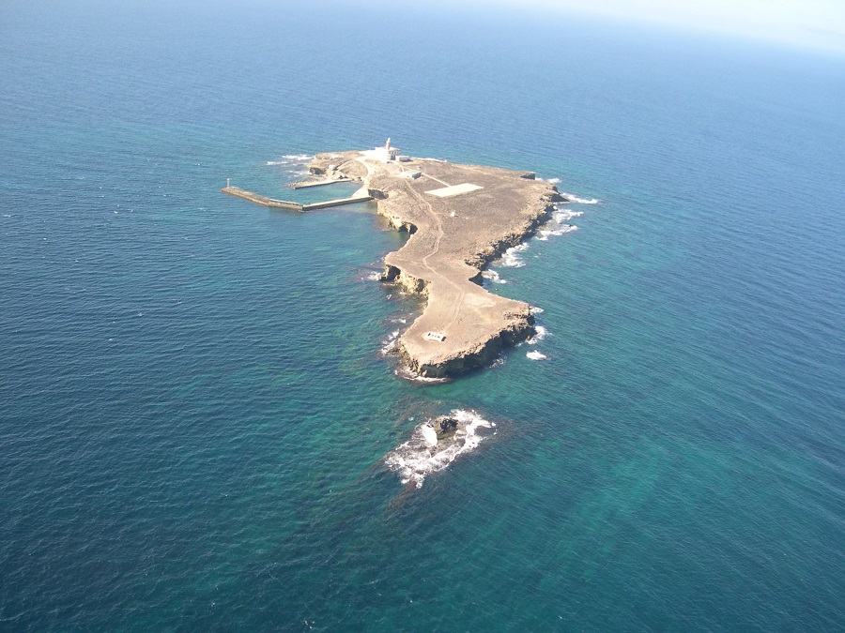
Where are we going to put the photovoltaic panels?
We have thought of putting the plates in a place that is at sea, we are going to put it specifically in the Sea of Alboran 35°59'29.6"N 3°13'43.7"W.

Slide 3
How much power does it have?
Solar panels at sea are also known as The Sun at Sea. The plates are capable of generating between 10 and 15 volts so the simplest plate is capable of generating 400W an average of 4 kWh per day and 124 kWh per month, it also all depends on how much energy you need. The installation of the plates counts 8800 euros to the government 9687.68 dollars.

Slide 4
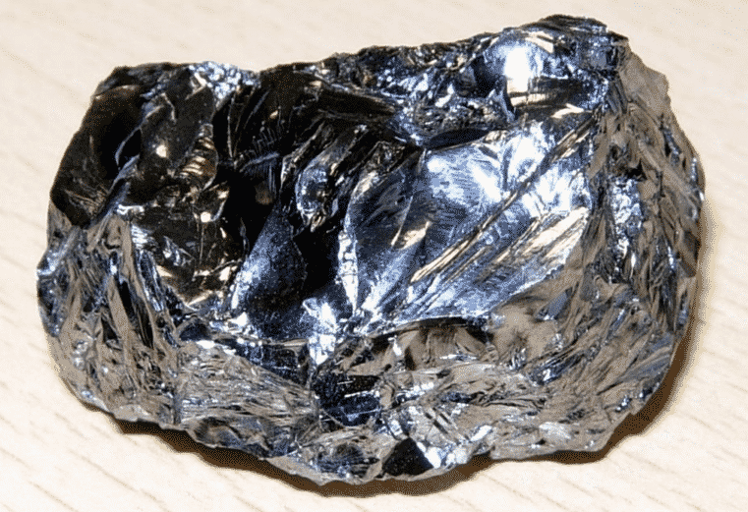
What materials are they made of?
Silicon is one of the most implemented components to build solar panels. In general, the silicon to manufacture these panels is cut into small pieces in the form of crystal circles.k

Slide 5
How much does a badge cost?
If you have 2 to 3 kWp, they cost about €3,500 to €4,500.
If you have 4 to 5 kWp, they cost about €4,500 to €6,000.
If you have 6 to 7 kWp, it costs about €6,000 to €8,000.
If you have more than 7kWp, it costs about €8,000 or more

Slide 6
What technology is used for solar panels?
The technology currently used in the realization of solar cells is that based on silicon, which is the one that has been developed commercially. New materials are being discovered and used that, in the future, will be able to replace silicon as the base element of solar cells.

Slide 7
What are the advantages of solar panels?
The main attraction of solar energy is that, unlike other sources, it does not generate polluting emissions either directly or indirectly. Once you install the solar kit, there will no longer be any greenhouse gas emissions. This is a good reason to opt for the installation of these devices.

Slide 8
Maintenance
.To keep the solar panel clean, it is enough to use water with a small amount of soap to make it easier to rinse later. It is not recommended to use detergents or rough cleaning materials since we can damage the surface of the panel permanently.

